Slide 1
An Introduction to iOS 13 Image

Slide 2
Overview
iOS Image Description
File System Structure
Understanding the Application Bundles

Slide 3
iOS 13 Image Description

Slide 4
About the iOS Image
Created by Joshua Hickman
Associate with Team Win Recovery Project (TWRP)
Created via Magnet Acquire
Running iOS 13.4.1
All files are included in the zip file iOS 13.4.1 Extraction.zip. Once extracted multiple files are present.
13.4.1.tar (Extraction)
iTunes Backup
Sysdiagnose Logs
Main Point of Investigation.
Requires Cellebrite or another forensic software to parse.
Allow developers to extract information from iOS devices, and it is used for understanding bug occurrences. However, this log is also useful for forensic purposes when a full device acquisition is not possible/available.

Slide 5
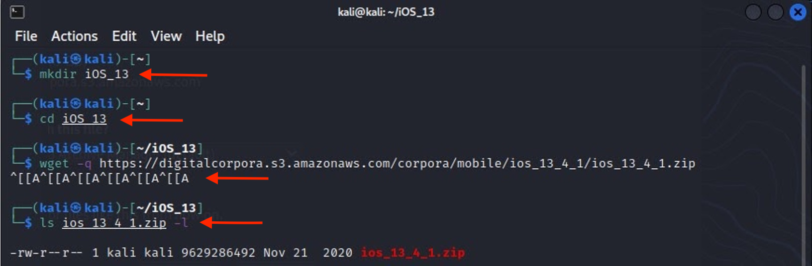
Downloading iOS 13 Image
A stock image of Android 10
Notes:
mkdir iOS_13
cd iOS_13
wget –q https://digitalcorpora.s3.amazonaws.com/corpora/mobile/ios_13_4_1/ios_13_4_1.zip
ls ios_13_4_1.zip -l

Slide 6
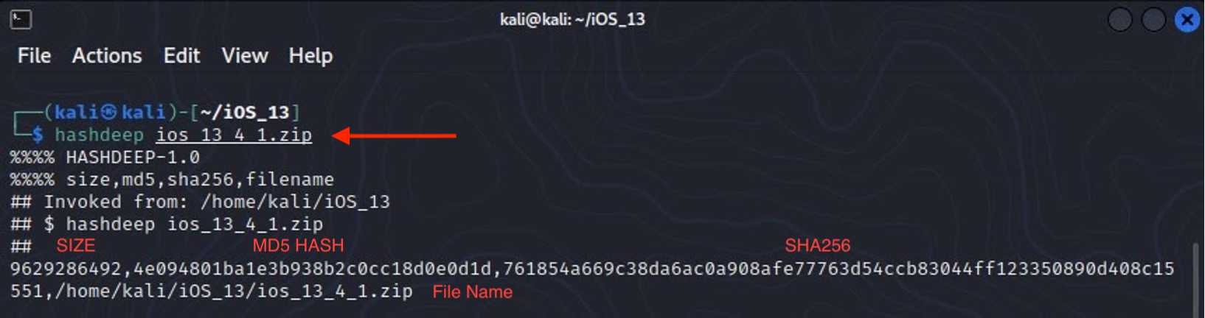
Verify hashes
MD5: 4e094801ba1e3b938b2c0cc18d0e0d1d
SHA-256: 761854a669c38da6ac0a908afe77763d54ccb83044ff123350890d408c15551
Notes:
hashdeep ios_13_4_1.zip
MD5: 4e094801ba1e3b938b2c0cc18d0e0d1d
SHA-256: 761854a669c38da6ac0a908afe77763d54ccb83044ff123350890d408c15551

Slide 7
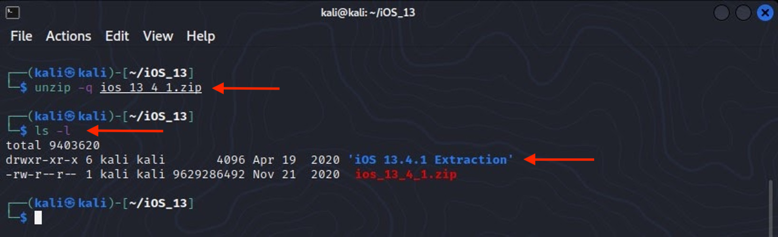
Unzip to get iOS 13 extraction
Notes:
unzip –q ios_13_4_1.zip
Ls –l

Slide 8
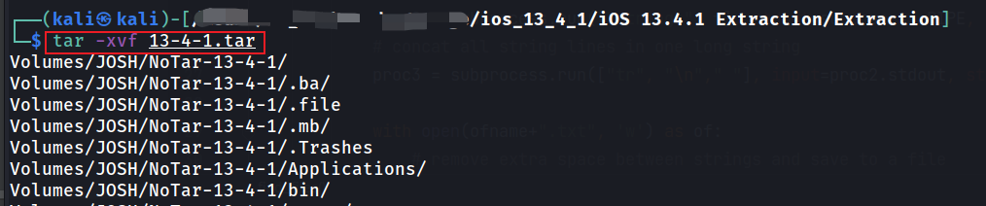
Unzip tar
x: It tells tar to extract an archive.
v: It tells tar to print its action on console.
f: It tells tar which file to perform the action on.
Notes:
tar –xvf

Slide 9

File System Structure

Slide 10
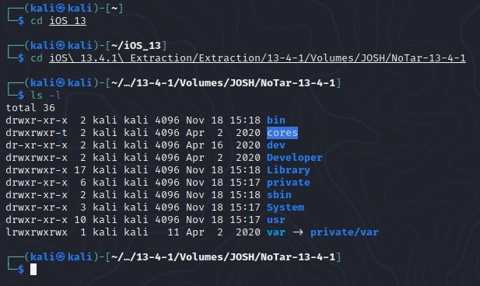
iPhone Root Level View:
Contain memory dumps, used for debugging.
device
Contains Device Nodes – used by kernel.
This folder is empty by default.
Contains files and executables required by all users and applications.
Contains non-root User Data.
Contains System OS and Frameworks
All these directories hold various essential binaries for the iOS file system.
Symbolic link to User Data
Notes:
cd iOS_13
cd iOS\ 13.4.1\ Extraction/Extraction/13-4-1/Volumes/JOSH/NoTar-13-4-1
ls –l

Slide 11
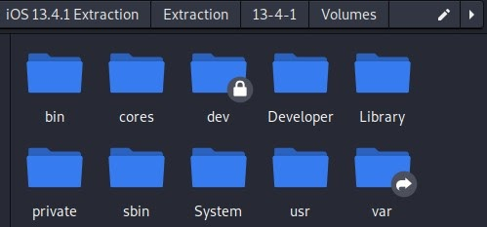
Root Level Folder View:
The lock icon means that a file or folder is owned by a privileged user, such as root
Symbolic Link to User Data ~/private/var

Slide 12
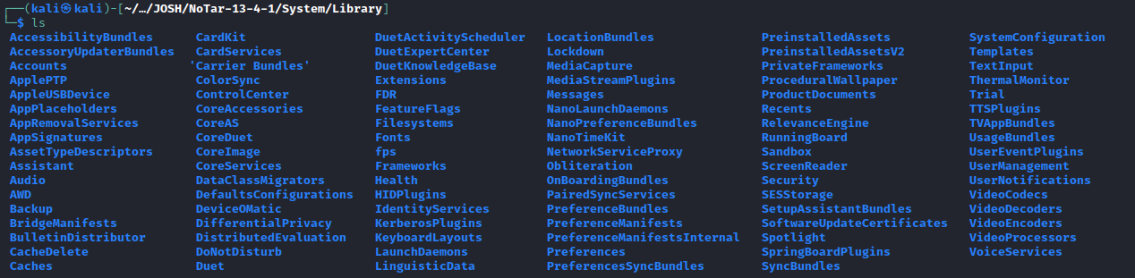
~/System/Library: iOS Building Block
This folder contains the bulk of the root partition. It contains Frameworks among many other things. Contains system configuration files critical to maintaining device's state.
Not to be confused with ~/var/mobile/library.
Notes:
Cd ~/System/Library
ls

Slide 13
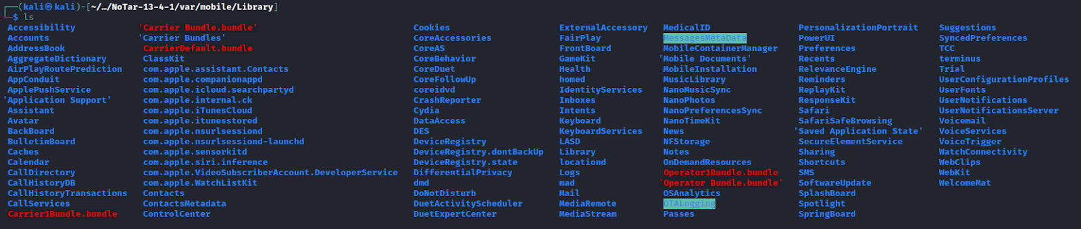
~/private/var/mobile/Library: User data storage
Contains:
All iOS app data
native apps or
3rd party
All system preferences/logs
All app generated data
Notes:
Cd ~/var/mobile/Library
ls

Slide 14
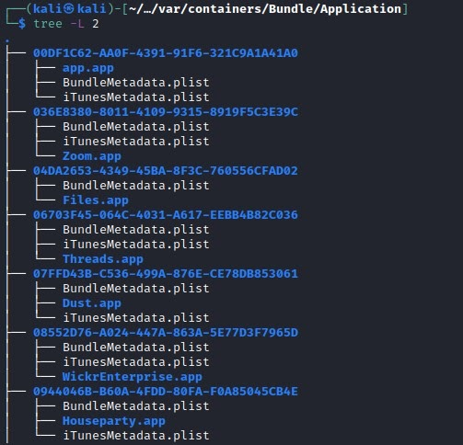
Where are applications installed?
Application data is stored in: ~/var/containers/Bundle/Application
This contains code, apple signatures, and frameworks, no user data.
Applications user data is stored in: ~/var/mobile/Containers/Data/Application.
This contains user generated data and preferences.
Notes:
Cd ~/var/containers/Bundle/Application
Tree –L 2

Slide 15

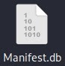
Understanding .plists and .dbs
Both are data storages
.plist contains property information about a variety of different Mac & iOS programs.
In XML format.
Install plistutility to read.
Install command: apt-get install libplist-utils
Usage example: plistutil -i Info.plist
.db or .sqlite are used to store any type information
Can be viewed with native program - DB Browser for SQLite.

Slide 16
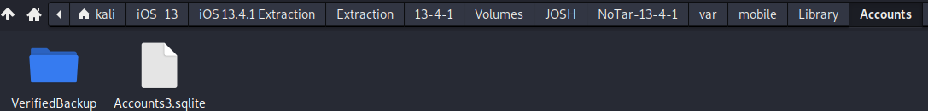
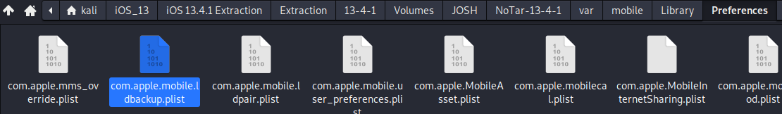
Generally Important .plists & .dbs (1)
Accounts3.sqlite – Found at ~private/var/mobile/Library/Accounts
Contains:
iCloud accounts present
iCloud accounts username.
Com.apple.mobile.ldbackup.plist – Found at ~private/var/mobile/Library/Preferences
Contains:
Last iCloud & iTunes backup date & time.
.
View with DB Browser

Slide 17
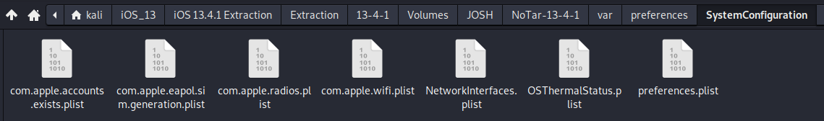
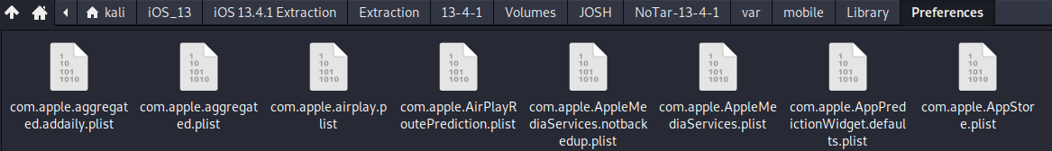
Generally Important .plists & .dbs (2)
Preferences.plist – Found at ~/var/preferences/SystemConfiguration
Contains:
Phone model number
Com.apple.AppStore.plist – Found at ~private/var/mobile/Library/Preferences
Contains:
Time zone information

Slide 18
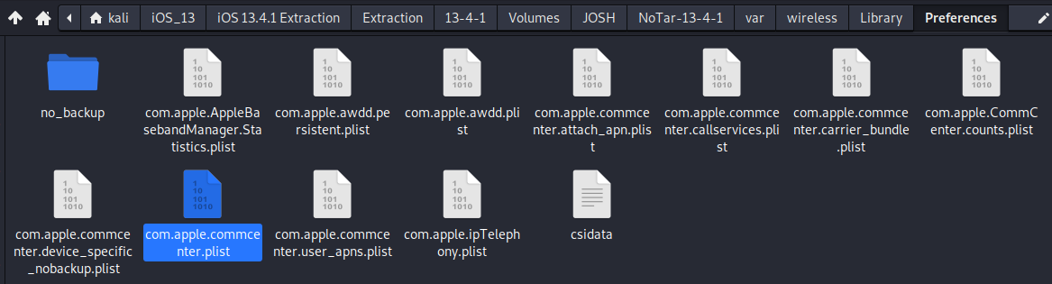
Generally Important .plists & .dbs (3)
Com.apple.commcenter.plist – Found at ~/private/var/wireless/Library/Preferences
Contains:
MSISDN - Mobile Station Integrated Services Digital Network – This is the phone number.
ICCID – Integrated Circuit Card Identifier – One of a kind signature that identifies the SIM card.
IMSI – International Mobile Subscriber Identity – Unique code used to identify mobile networks & users

Slide 19
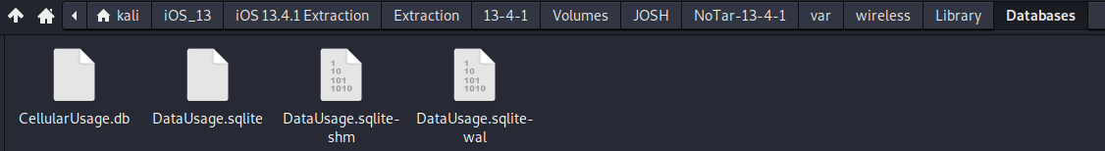
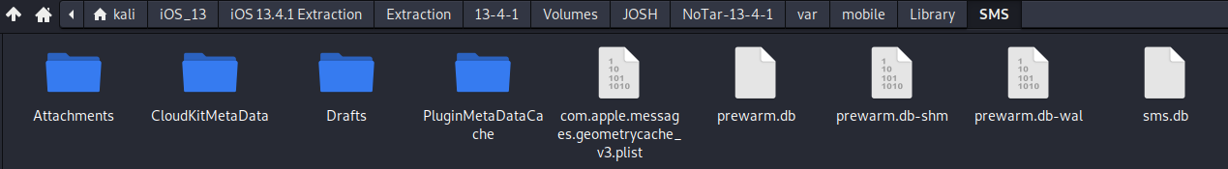
Generally Important .plists & .dbs (4)
CellularUsage.db – Found at ~/private/var/wireless/Library/Databases
Contains:
Last used ICCID & last used MSISDN
Sms.db – Found at ~/private/var/mobile/Library/SMS
Contains:
Information on iMessage Message Retention Duration.

Slide 20
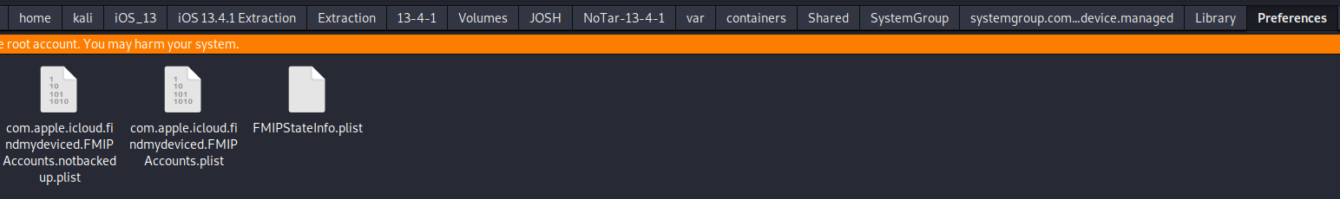
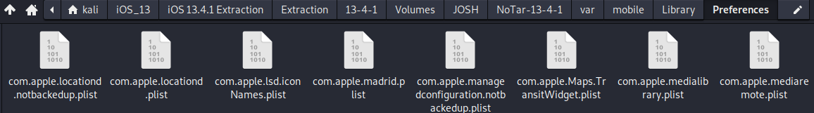
Generally Important .plists & .dbs (5)
Com.apple.icloud.findmydeviced.FMIPAccounts.plist – Found at ~/private/var/containers/Shared/SystemGroup/systemgroup.com.apple.icloud.findmydevice.managed/Library/Preferences
Contains:
Information if Find my iPhone is enabled. Need Root Privileges to view this folder.
Com.apple.locationd.plist - Found at ~/private/var/mobile/Library/Preferences
Contains:
Information if Location services are enables.

Slide 21

Understanding Application Bundles

Slide 22
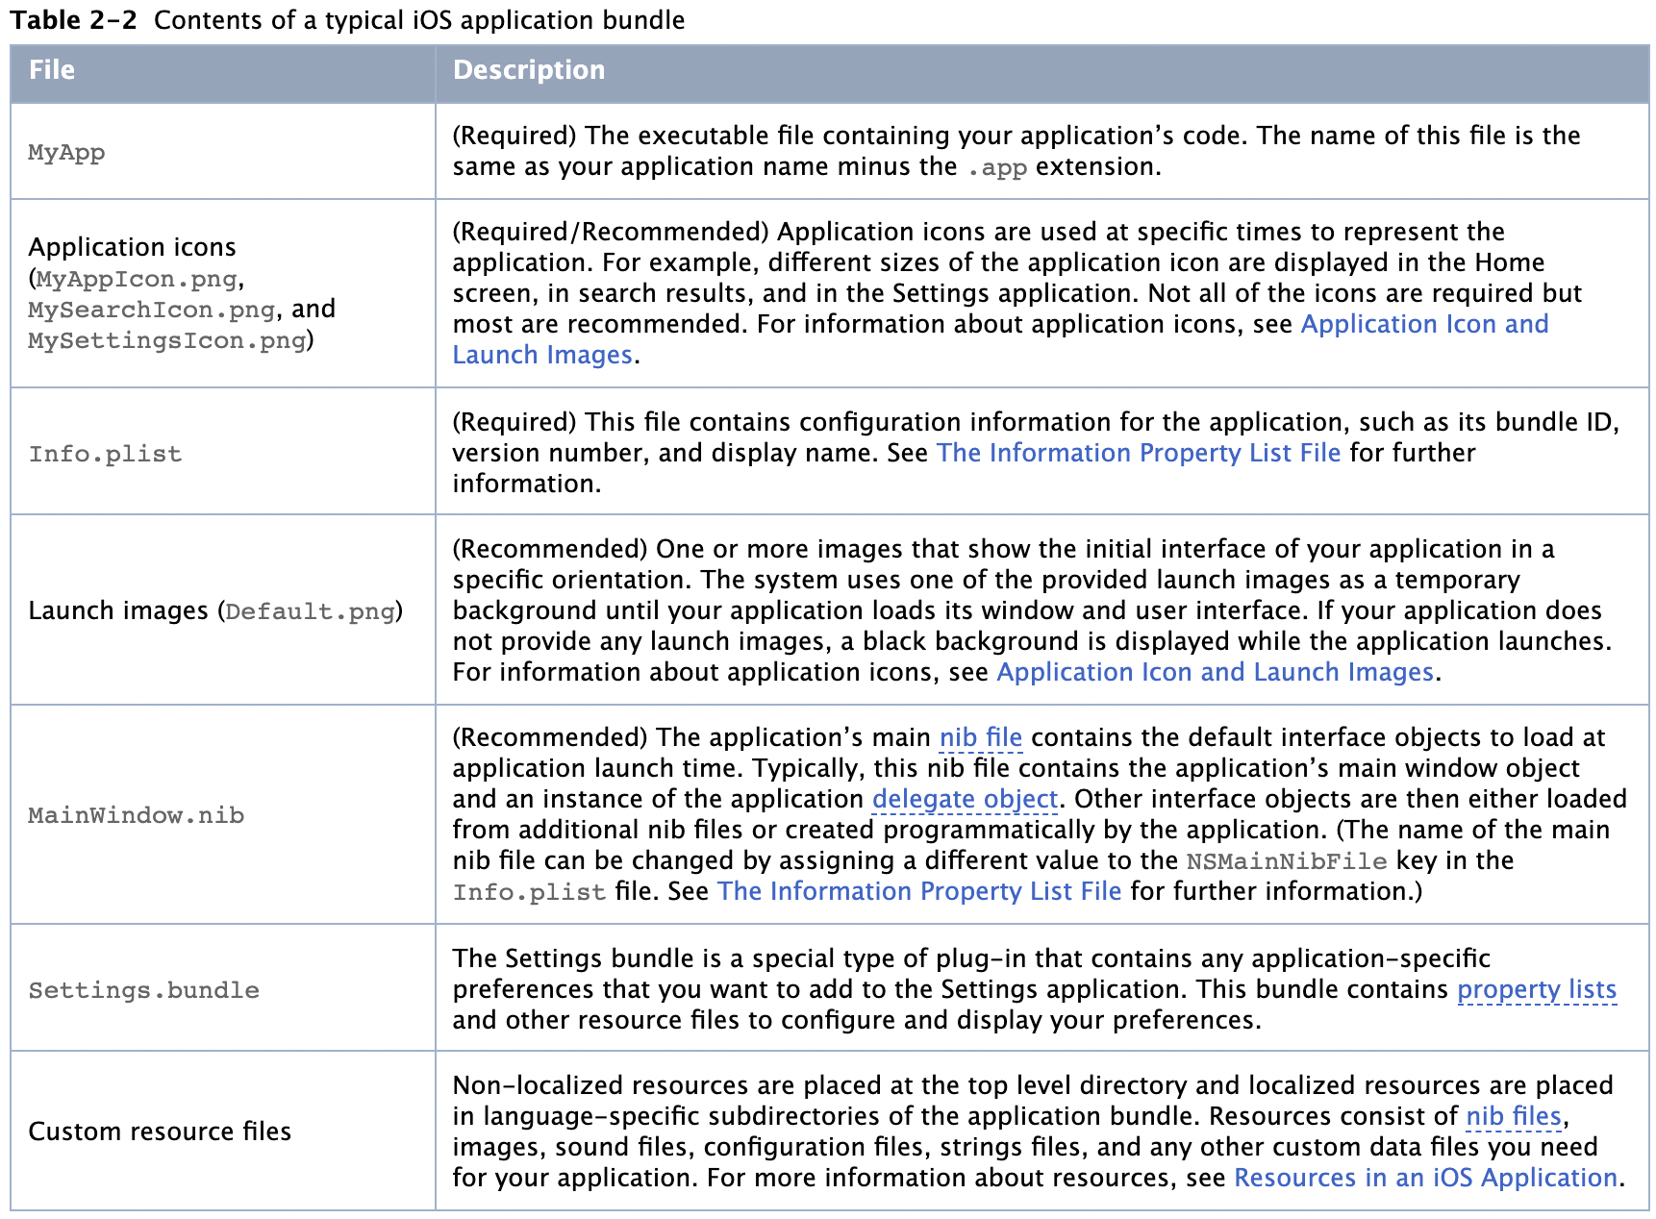
The iOS Application Bundle Structure:
Application bundles are one of the most common types of bundle created by developers. The application bundle stores everything that the application requires for successful operation. Although the specific structure of an application bundle depends on the platform for which you are developing, the way you use the bundle is the same on both platforms (Mac & iOS).
Notes:
https://developer.apple.com/library/archive/documentation/CoreFoundation/Conceptual/CFBundles/BundleTypes/BundleTypes.html

Slide 23
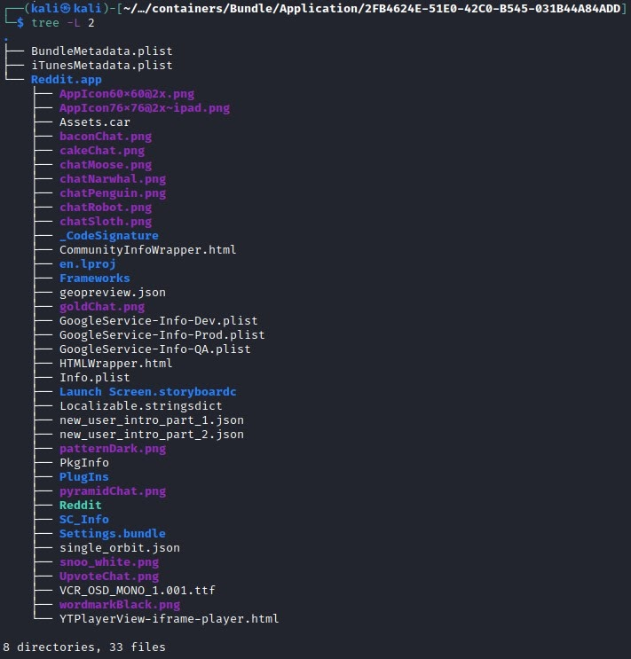
Example of App Bundle from Image Reddit.app
Application related icons and launch images (.png)
Signature file used to verify authenticity of application.
Info.plist contains configuration information for the application. (every application will have an info.plist)
Frameworks folder
Application Plugins
Executable
Notes:
Tree –L 2

Slide 24
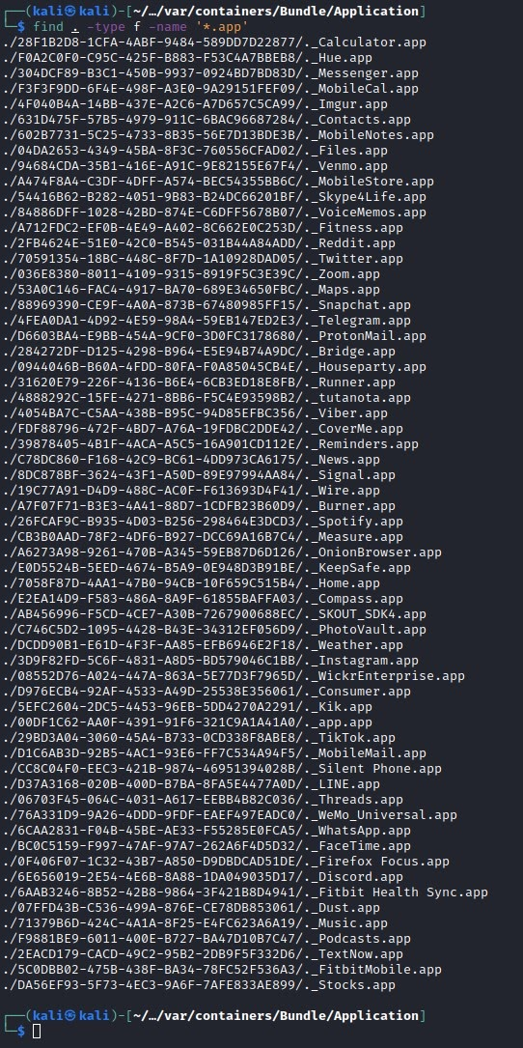
Finding list of all currently installed apps:
Inside ~/var/containers/Bundle/Application
find . –type f – name ’*.app’
Both First and Third-party apps included in this folder.
No user data included. Contains source code and related files.
Notes:
Cd ~/var/containers/Bundle/Application
find . –type f – name ’*.app’

Slide 25
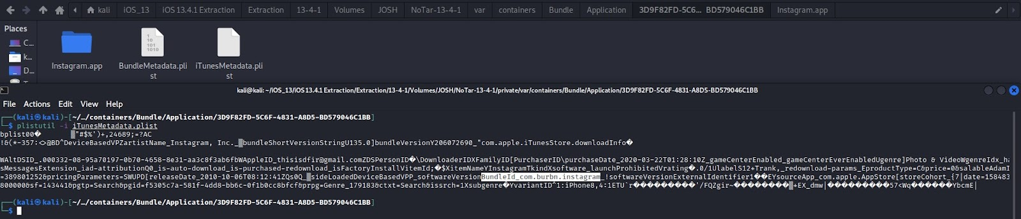
What is the name of Application for a given BundleID? (Instagram vs BundleID_com.burbn.instagram)
To find a BundleID navigate to an app folder in ~/var/containers/Bundles/Application
Located in iTunesMetadata.Plist.
Notes:
Plistutil –I iTunesMetadata.plist

